Slide 1
Lecture 14
Binary Trees

Slide 2
Outline
Tree Structure
Binary Trees
  Definition
  Implementation of Binary Trees
  Traversal of Binary Trees

Slide 3
Tree Structure

Slide 4
Terminologies
root, child, parent, leaves, siblings, subtree, grandparent, grandchild, ancestor, descendant

Slide 5
Terminologies
A path from node n₁ to n_{k} is defined as a sequence of nodes n₁, n₂, ..., n_{k} such that n_{i} is the parent of n_{i+1} for 1≤i<k. The length of this path is the number of edges on the path, namely k-1.
For any node n_{i}, the depth of n_{i} is the length of the unique path from the root to n_{i}. The root is at depth 0. The height of n_{i} is the length of the longest path from n_{i} to a leaf. All leaves are of height 0. The height of a tree is equal to the height of the root.

Slide 6
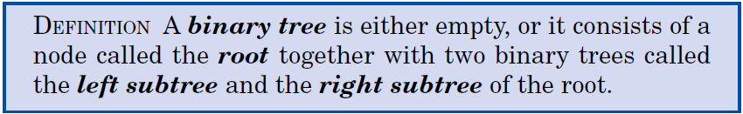

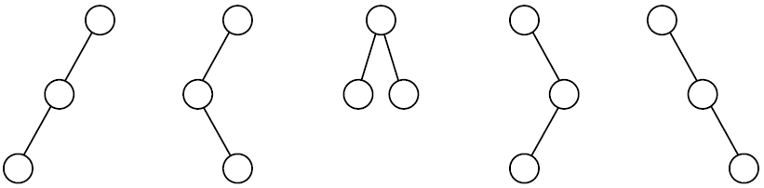
Binary Trees
There is one empty binary tree, one binary tree with one node, and two with two nodes:
The binary trees with three nodes are:

Slide 7
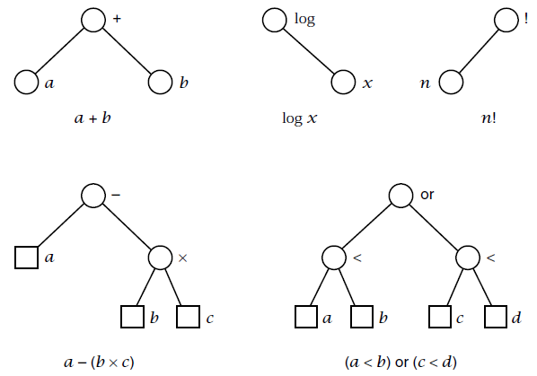
Expression Trees
An expression tree is a binary tree such that every node is labeled by a binary operator or unary operator, its left subtree denotes its left operand and right subtree its right operand.

Slide 8
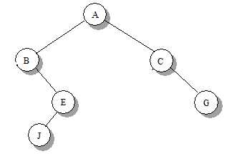
Binary Trees: Sequential Storage
The root of the tree is in position 0 of the list, then the left and right children of the node in position k are in positions 2k+1 and 2k+2 of the list, respectively.
The tree of height k needs 2^{k} spaces. Not effective!
0 | 1 | 2 | 3 | 4 | 5 | 6 | 7 | 8 | 9
A | B | C | ^ | E | ^ | G | ^ | ^ | J

Slide 9
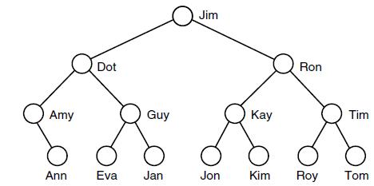
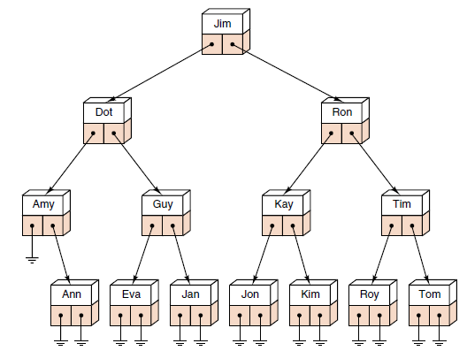
Linked Implementation of Binary Trees
A natural implementation is in linked storage. A node has two pointers that denote its left and right subtrees.

Slide 10
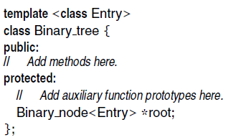
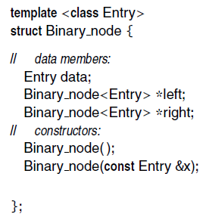

Linked Binary Tree Specifications
Binary tree class: Binary node class:
Node structure:

Slide 11
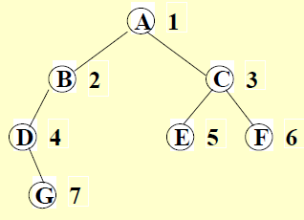
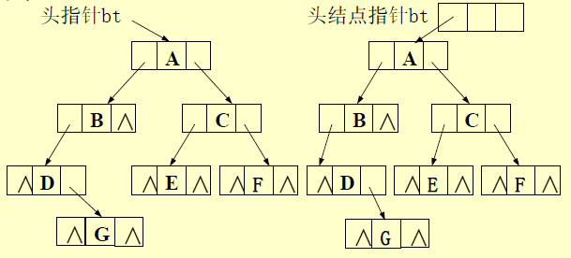
Binary Tree with/without Head Node

Slide 12

Traversal of Binary Trees
At a given node there are three tasks to do in some order: Visit the node itself (V); traverse its left subtree (L); traverse its right subtree (R). There are six ways to arrange these tasks:
(V L R) (L V R) (L R V) (V R L) (R V L) (R L V)
By standard convention, these are reduced to three by considering only the ways in which the left subtree is traversed before the right.
These three names are chosen according to the step at which the given node is visited.

Slide 13
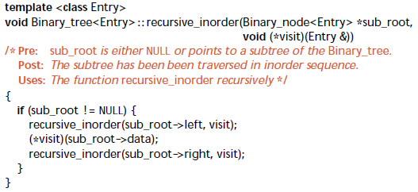
Tree Traversal (in-order)
A
B
C
D
E
F
G
H
I
in-order: G, D, H, B, A, E, I, C, F

Slide 14
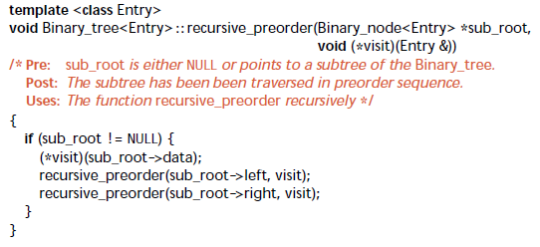
Tree Traversal (pre-order)
A
B
C
D
E
F
G
H
I
pre-order: A, B, D, G, H, C, E, I, F

Slide 15
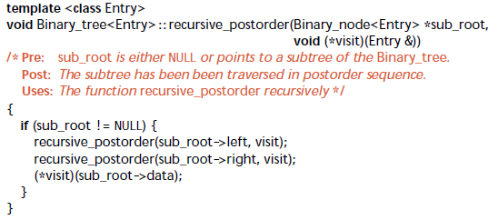
Tree Traversal (post-order)
A
B
C
D
E
F
G
H
I
post-order: G, H, D, B, I, E, F, C, A

Slide 16
Tree Traversal (level-by-level)
层次遍历：若树为空，则空操作返回，否则从树的第0层，也就是根节点开始访问，从上而下逐层遍历，在同一层中，按从左到右手的顺序对结点逐个访问。
A
B
C
D
E
F
G
H
I
Level traversal: A, B, C, D, E, F, G, H, I

Slide 17
Tree Traversal (level-by-level)
struct BinaryNode {
int data;
BinaryNode *left, *right;
};
void traversal(BinaryNode *p)
{
queue<BinaryNode*> q;
BinaryNode *cur;
if (p != NULL) q.push(p);
while (!q.empty()) {
cur = q.front();
q.pop();
printf("%d ", cur->data);
if (cur->left != NULL) q.push(cur->left);
if (cur->right != NULL) q.push(cur->right);
}
}

Slide 18
Construct Binary Tree from Different Traversal Orders
Given inorder and postorder traversal of a tree, construct the binary tree.
Preorder: ABCDEF → (A)(BC)(DEF)
Inorder: CBAEDF → (CB)(A)(EDF)
A
B
D
C
E
F
A
C
B
E
D
F

Slide 19
Construct Binary Tree from Different Traversal Orders
Left Subtree
Preorder: BC → (B)(C)
Inorder: CB → (C)(B)
Right Subtree
Preorder: DEF → (D)(E)(F)
Inorder: EDF → (E)(D)(F)
B
C
B
D
E
D
F
C
E
F
Exercise:
Preorder: ABCDEFGHI
Inorder: BCAEDGHFI

Slide 20
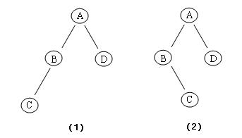
Construct Binary Tree from Different Traversal Orders
Given preorder and postorder traversal of a tree, construct the binary tree.
May Not Be Unique!
Example:
Preorder: ABCD
Postorder: CBDA

Slide 21

Thank you!

